Slide 1
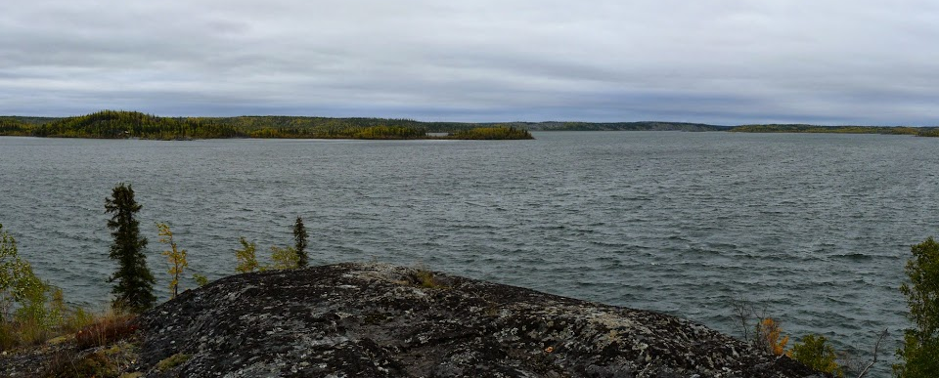
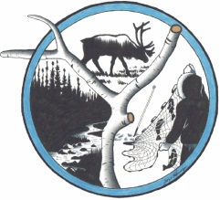
Legacy Contamination Public Engagement Meeting
May 10, 2018
Canada North Environmental
Services Limited
Notes:
Prosperous Lake; from http://travelnorthof60s.blogspot.ca/2015/02/yellowknife-river-2009.html

Slide 2
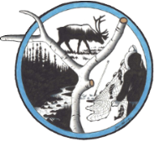
Background
The Government of Northwest Territories (GNWT) and Indigenous and Northern Affairs Canada (INAC) are working together to address the legacy arsenic contamination concerns around Yellowknife:
  Canada North Environmental Services (CanNorth) is carrying out a human health risk assessment (HHRA) for the stack shadow area of the Giant Mine, primarily to the west and northwest of the site.
  CanNorth previously worked on the Giant Mine human health and ecological risk assessment (HHERA).

Slide 3
Stack Shadow Area
Developed from:
  Wind direction: predominant wind direction from the east and south
  Monitoring data: concentrations in environmental media are essentially at background at a distance of 25 km from the Giant Mine
  Water health advisory: considered mapping developed by GNWT Health to capture elevated arsenic concentrations in inland lakes
  Distance: considered distances within a 10 km and 25 km radius of the Giant Mine

Slide 4
Additional Areas Considered
Inland lakes with cabins added to the scope of the project
  Ryan, Vee, and Walsh lakes – essentially within the stack shadow area
  Banting, Prosperous, River, Prelude, and Pontoon lakes – outside the stack shadow area

Slide 5
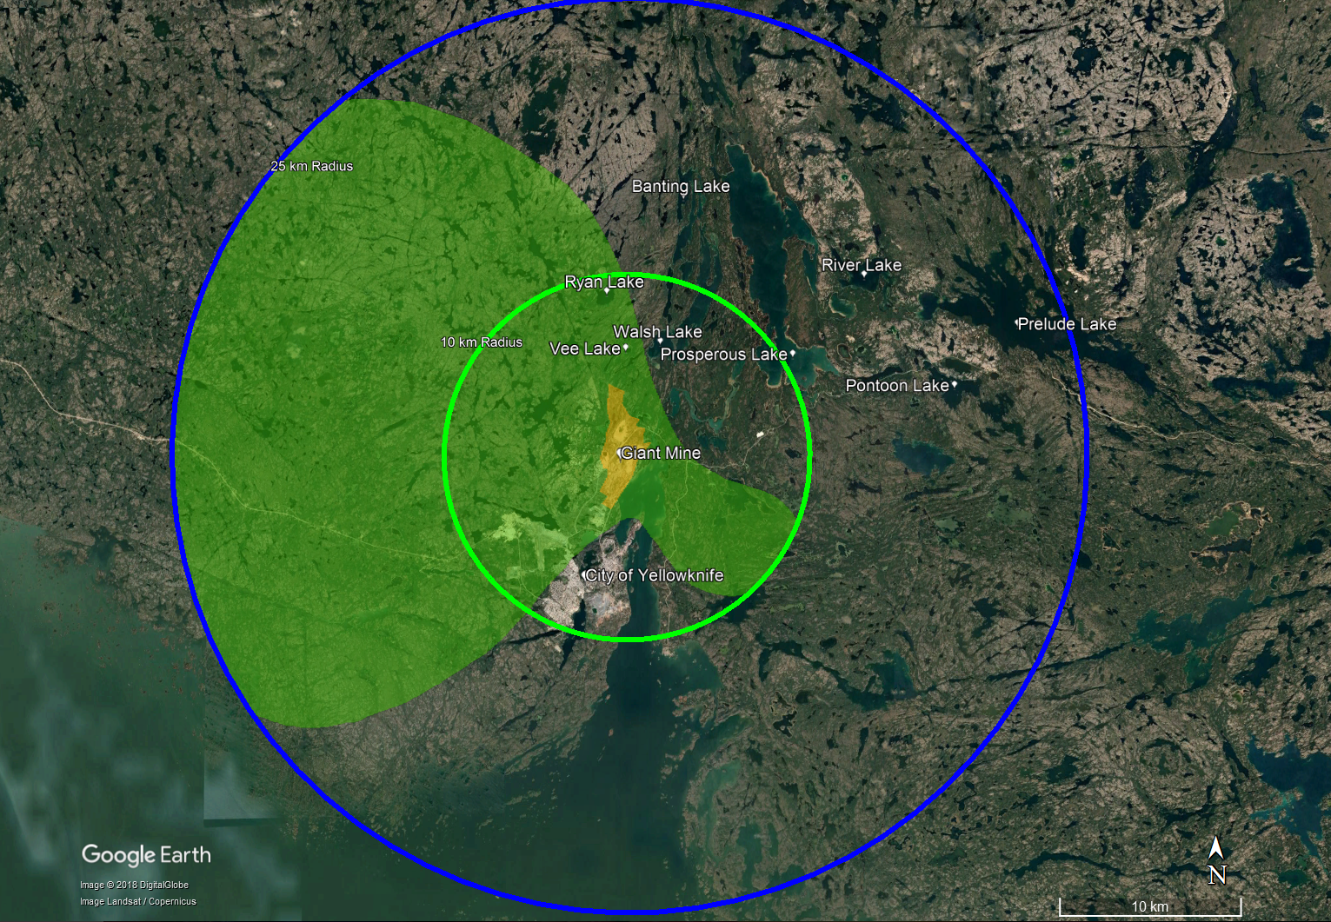
Assessment Area

Slide 6
Constituents of Potential Concern
2018 HHERA for Giant Mine found that antimony and arsenic were the key constituents of potential concern (COPC)
  Confirmed by soil screening of data from stack shadow area
Mercury could be elevated in sediments of inland lakes
  Not a COPC associated with Giant Mine
  Mercury concentrations are elevated in water due to sulphate from emissions from the roaster
  Accumulates in fish
  Mercury added to list

Slide 7
Data Gaps Analysis
Summarized available data from off-site Giant Mine, focusing on the stack shadow area and around inland lakes with cabins
  Aquatic environment: surface water, sediment, fish
  Terrestrial environment: soil, berries, mushrooms, wild plants (medicinal)
  Wild game: birds, waterfowl, moose, small mammals
Identified any data gaps for completing the HHRA

Slide 8
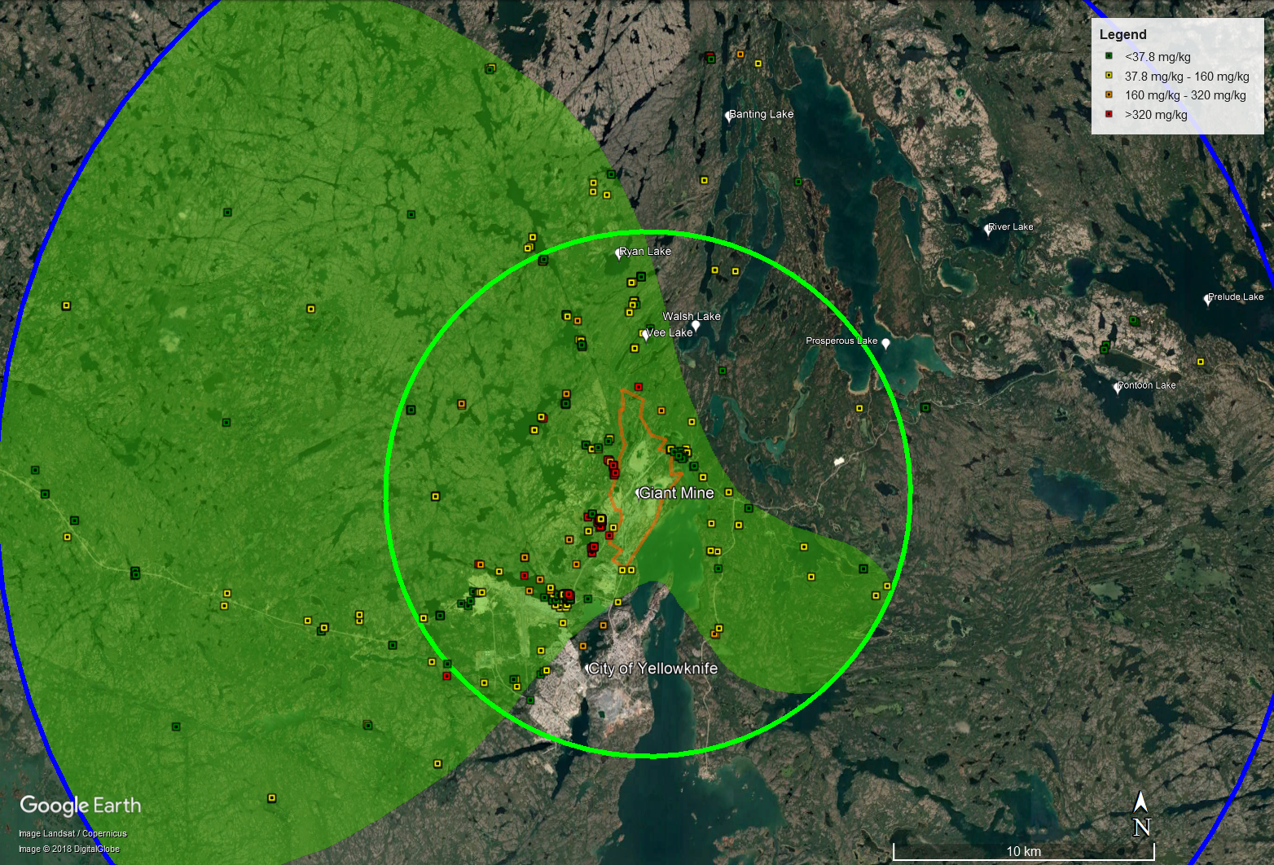
Arsenic Levels in Soils

Slide 9
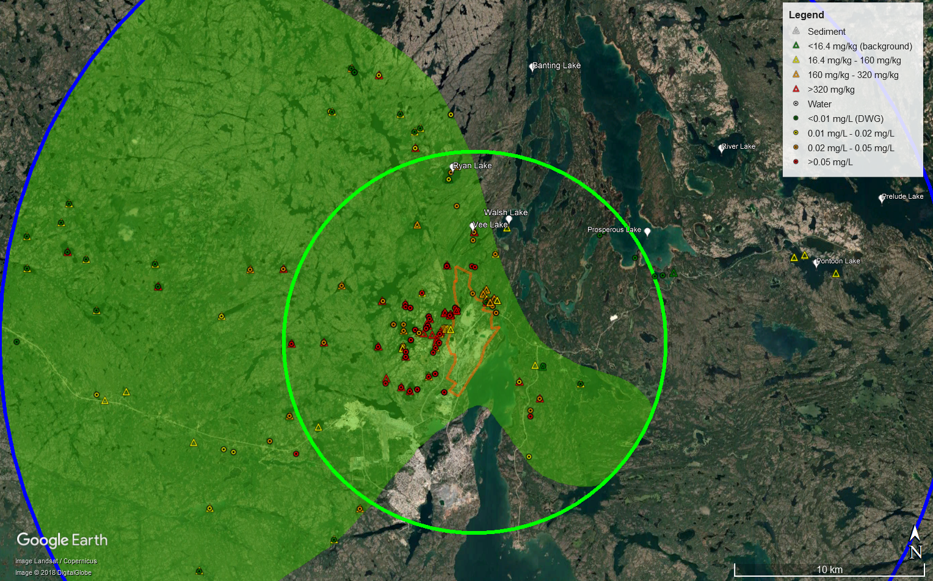
Arsenic Levels in Water and Sediment

Slide 10
Data Gaps – Inland Lakes within the Stack Shadow
Medium | Adequate Samples?
Soil | Yes – More than 200 samples available
Surface Water | Yes – More than 80 samples available
Sediment | Yes – About 70 samples available
Fish | No – Data only available for Lower Martin Lake
Berries | Limited samples within the stack shadow area
Mushrooms | Yes – More than 30 samples available
Medicinal Plants | Limited samples within the stack shadow area
Wild Game | Limited samples within the stack shadow area

Slide 11
Data Gaps – Lakes with Cabins
Lake | Adequate Samples?
 | Soil | Surface Water | Sediment | Fish
Vee Lake | Yes | Limited - 2 | Limited - 1 | No data
Walsh Lake | Yes | Limited - 1 | Limited - 1 | No data
Banting Lake | Yes | No data | No data | No data
Prosperous Lake | Yes | Yes | No data | No data
Prelude Lake | Yes | No data | No data | No data
Ryan Lake | Yes | Yes | Limited - 2 | No data
River Lake | No data | No data | No data | No data
Pontoon Lake | Yes | Limited - 2 | Yes | No data
Notes:
For River Lake data from other lakes considered to be representative; added in Ryan Lake (have 3 surface water so no more water needed there)

Slide 12
How Will Data Gaps be Filled?
Fish
  Need a more robust data set
    University of Ottawa conducted a fish study in a number of inland lakes including Long Lake, Lower Martin Lake, Walsh Lake, Banting Lake, and Chitty Lake
    Voluntary community fish sampling program in summer of 2018
Water and sediment
  Need a more robust data set for lakes with cabins
    Samples will be collected in summer of 2018
Notes:
Fishing Day or through the fishing licence process

Slide 13
What Information Do We Need Today?
What areas do you go to?
How long do you spend in these areas?
How do you use these areas?
  Going to a cabin, boating, fishing, hunting, etc.
Do you swim or wade in the lakes?
Do you hike in the area within the stack shadow?

Slide 14
How Will We Get the Information?
Form smaller groups of people
We will ask some questions to the group
We will ask you to mark on a map the areas that you use
This will all take about half an hour or so
There is also an on-line questionnaire if you prefer

Slide 15
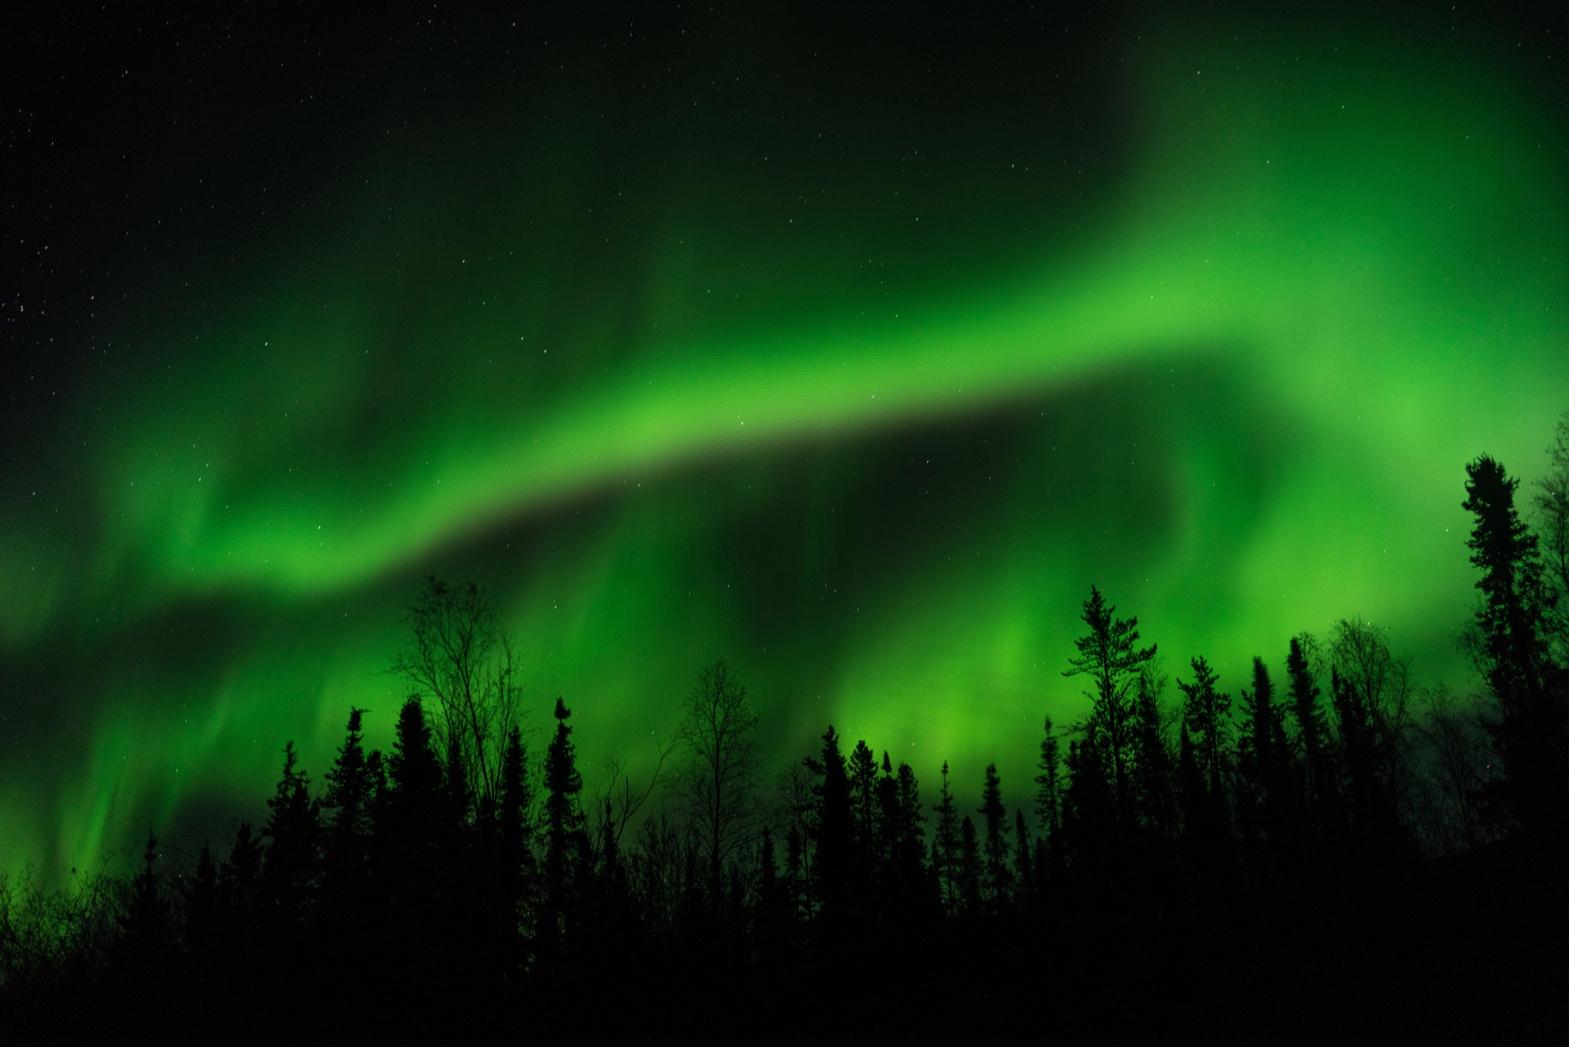
Thank-you

